Slide 1
Environmental Program in Partnership between Zero Waste Laos and NPA Laos

Slide 2
Content
Background
Our Vision
Key Achievements
Next step

Slide 3
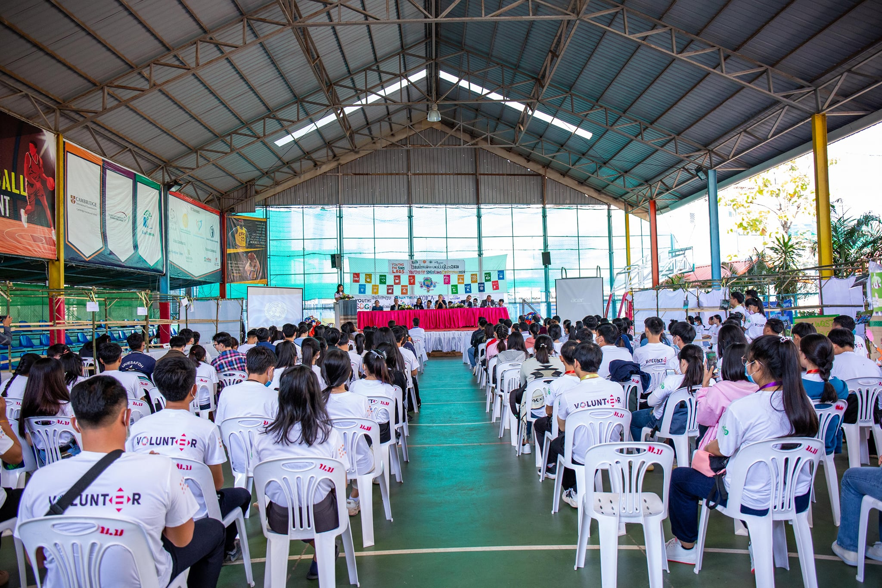
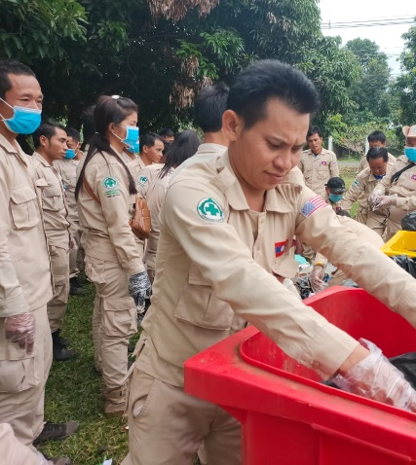
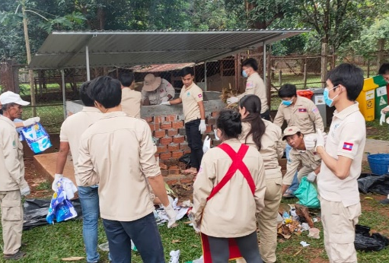
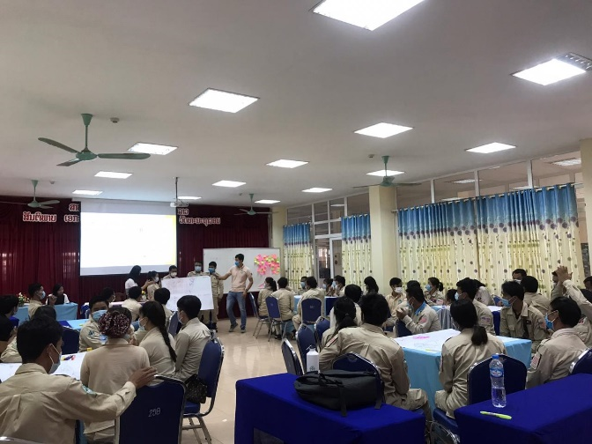
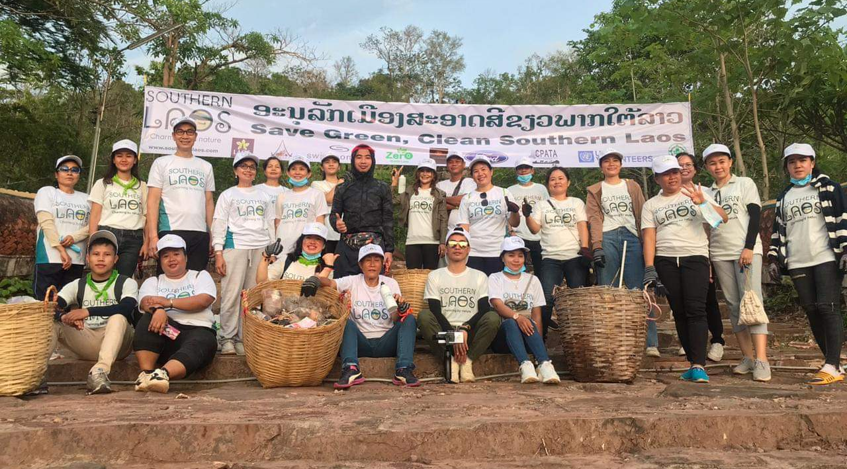
Background
December 2019, the first meeting between Zero Waste Laos and Norwegian People’s AID
2020, Conducting Survey and Training for 400 staffs of NPA Laos
Supporting Zero Waste Laos activities such as Save Green Clean Southern Laos, Youth for SDGs Laos Conference and Youth for SDGs Southern Laos

Slide 4
What are the vision and target of NPA Laos on environmental protection?
CHAMPION ON ENVIRONMENTAL PROTECTION IN LAOS AND REGION
REDUCE CARBON FOOTPRINT
REDUCE SINGLE USE PLASTIC
GREEN OFFICE AND GREEN OPERATION
SUPPORT COMMUNITY AND YOUNG GENERATION TO PROTECT ENVIRONMENT

Slide 5
Key Achievements in 2021
Conduct Environmental Training for NPA staffs
Develop Green Office and Green Operation tool
Providing key points for the update of national strategy of Mine action for 2021-2030
Review and update of the National standard
Youth Climate Action Conference
Youth for SDGs in 3 Provinces of Southern Laos
Sustainability Leaders Program

Slide 6
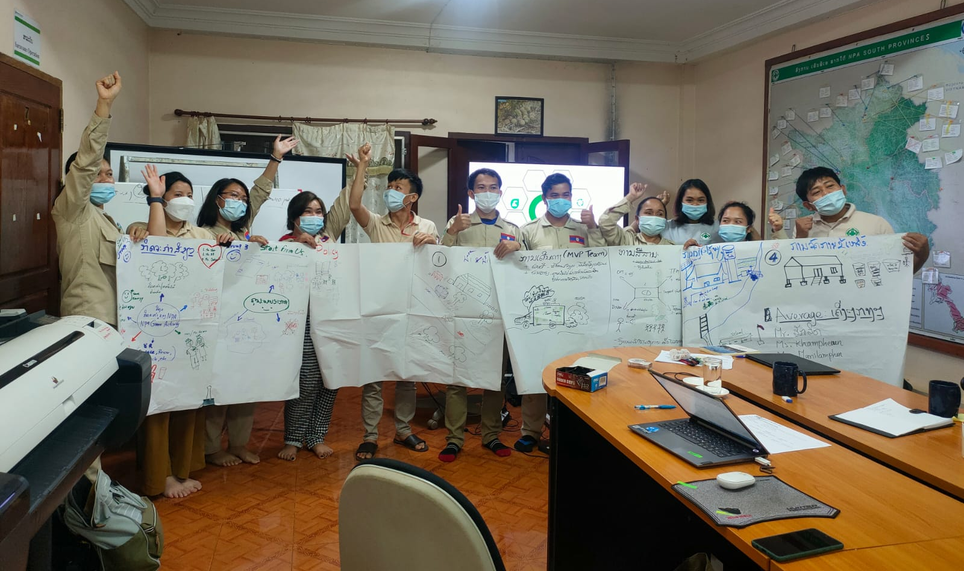
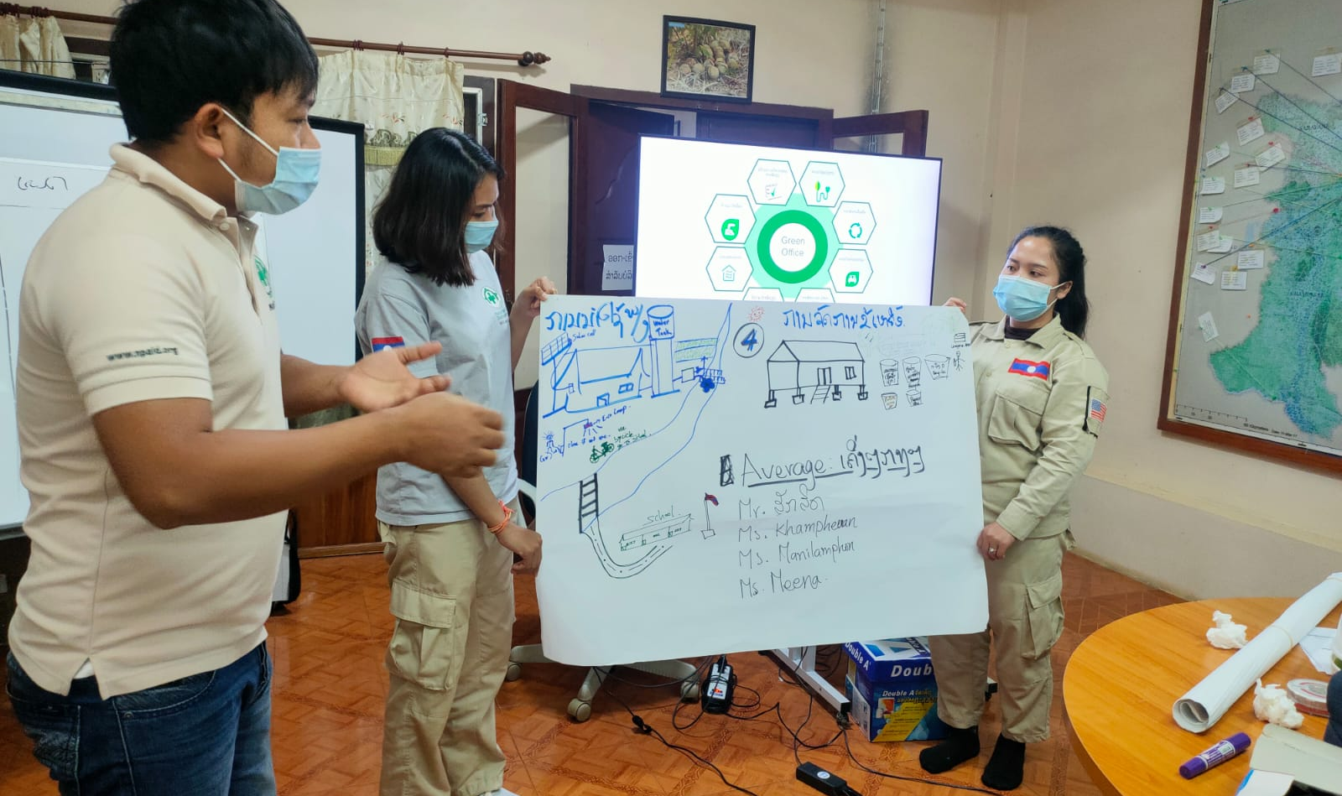
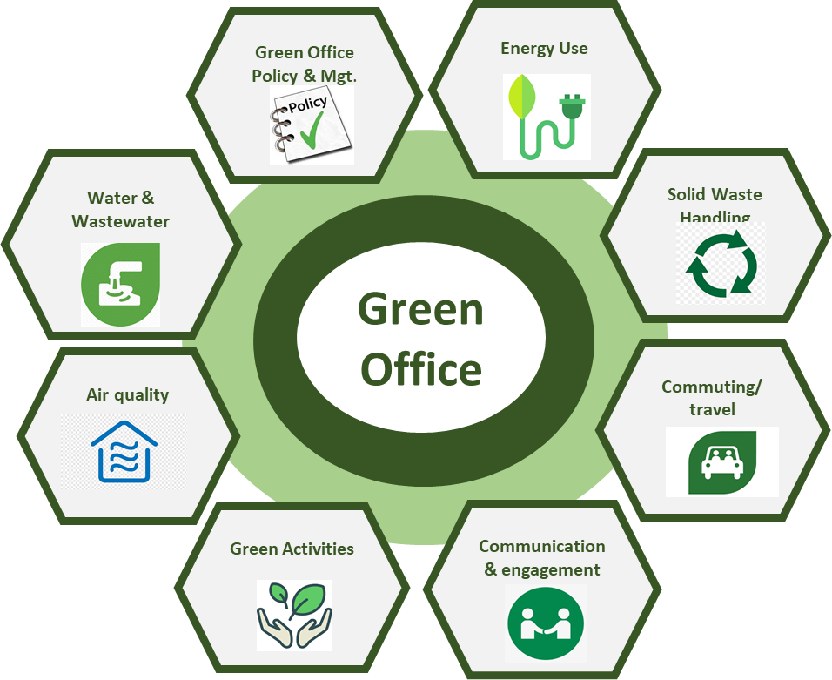
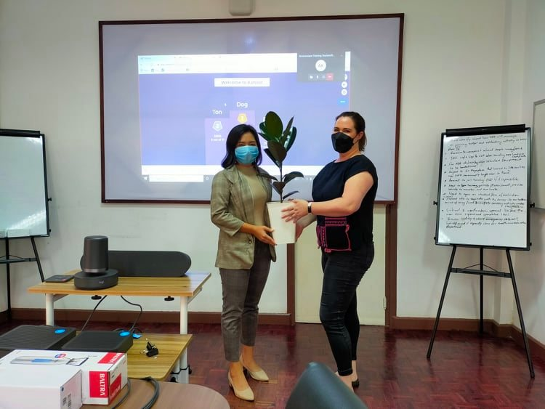
Green Office Training
The training was conducted for all staff in Vientiane office and Pakse office as in Person. The training focused on reduce carbon footprint and increase awareness of staffs in 8 components:

Slide 7
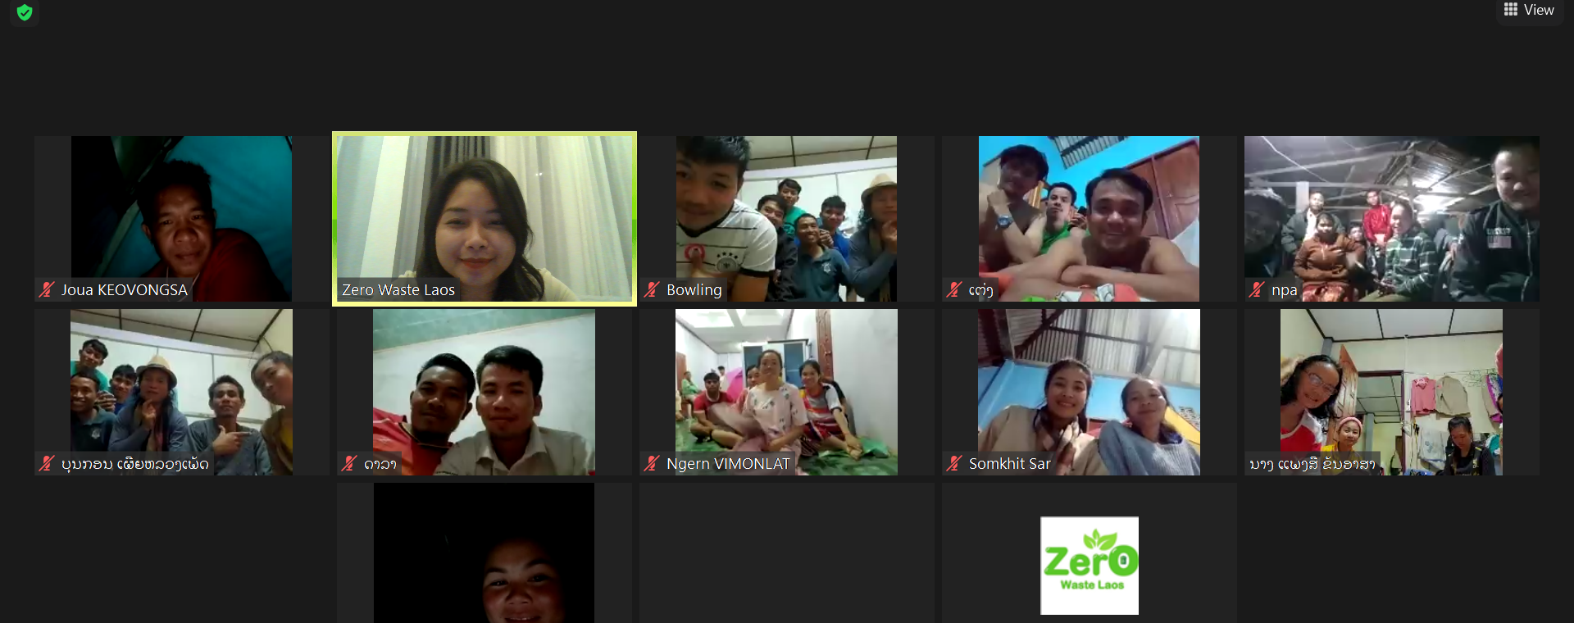
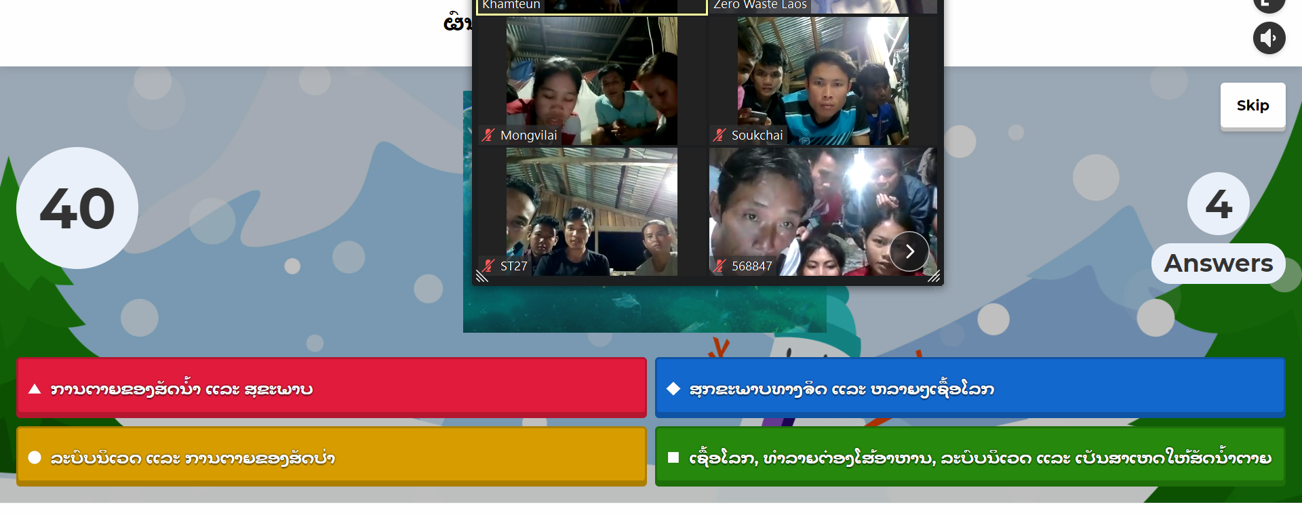
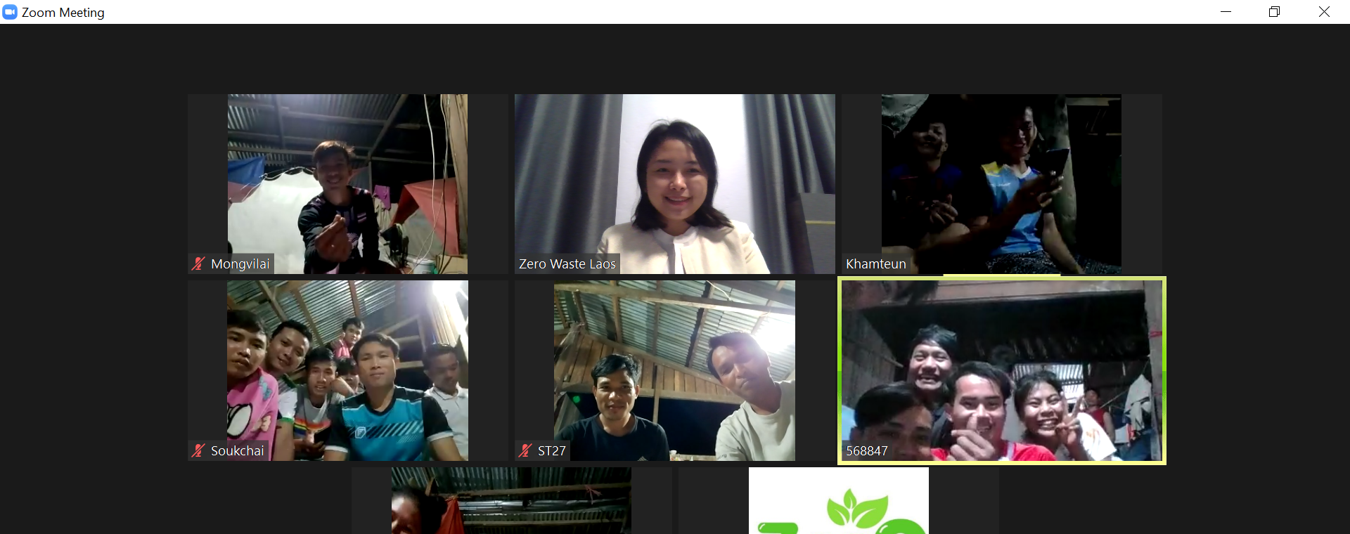
Green Operation Training
Due to Covid Restriction, the green operation was conducted online for all the staffs. It was 4 days training and divided in 4 province ( one day one province ). Staff learned about measures to prevent soil erosion and avoid soil degradation caused by operations, and measures to reduce pollution to air, water, and soil by emissions of toxic or hazardous chemicals. As UXO removal can affect the wildlife and vegetation
The trainings featured environmental considerations such as
Camp location selection
Water supply
Solid waste,
Human waste,
Wastewater
Demobilization.

Slide 8
Which stage we are?
0
1
2
3
4
Stage 0 mainly refers to the offices current state of operation, which may be referred to as business as usual (BAU). This stage is considered on the scoring scale as base/ reference year in regards to all dimensions (components) considered in relation to emissions and resource consumption. On the scoring metric, stage 0 earns zero point and remains the reference point for build up of subsequent green office actions
The stage 1 mostly embodies a set of actions/interventions related to behavioural change of staff and management in the office. The implementation of stage one actions are generally deemed to have little to no resource requirements, easily implementable and does not require major input and shift to existing structures of the office (physical and managerial.
Stage 2 interventions mostly embodies actions that the office and management takes relating to adoption of simple less expensive investment in smart technologies and regulators or sensors that helps improve efficiency and reduce emission in the office
A little above stage 2, the stage 3, interventions embdy the use installation of equipments and gadgets that require a little more expensive investment by the office in anticipation of long term benefits. These interventions require resource investments and, installations of gadgets and equipment, and making changes that brings drastic changes to the existing operations of the office.
Stage 4 Considered as the most engaging and demanding in terms of resource commitment and difficulty of implementation, the stage 4 is the highest attainable score that includes all actions, interventions that are highly drastic and capital and resource intensive. These interventions is expected to result in higher emission savings than the rest of of the lower stages.

Slide 9
Data Requirement
Data requirements under section A of questionnaire
Parameter/element | Value
Number of staff in office/organisation
Electricity source
Electricity consumption per month (energy used (kWh for gas and electricity) per floor area (m2)
Electricity consumption estimations for lighting
Electricity consumption estimations consumption of electrical and electronic devices
Electricity consumption estimations consumption of air conditioners
Annual/ monthly water use (m3);
Estimated waste water generation monthly (m3)
Estimated Amount of water saved (m3)
Estimated Amount of waste water recycled (m3)
Kg/ Tonnes of waste disposed
Paper use by office or per staff (reams or kg);
Office and canteen waste recycled per member of staff (%).
Daily and annual waste generation by office (kg) (disaggregated)
Number of cars owned by office
Types of cars owned and number distance travel per month (m3)
Number green plants (n), green walls or space (m3)
Number and type of green activities per year

Slide 10
Solid Waste Handling
At VTE office

Slide 11
The changes of NPA’s staff behaviour

Slide 12
Policy work
Strategy of UXO 2021-2030
Update National UXO action standard
Amendment to align to the current environmental standards and requirements.
The IMAS 07.13 provided an all-encompassing framework and reference for the development and update of the Lao PDR national standard.
The updated National standard followed closely the scope outlined in the IMAS 07.13, along with elements from EAM tool, and ZWL experience on environmental management in Lao PDR.
Standardization of UXO Clearance/Mine action operations to in the region.
Input the Habitat loss and habitat reduction of wildlife and endangered or protected species, deforestation and forestry/vegetation loss

Slide 13
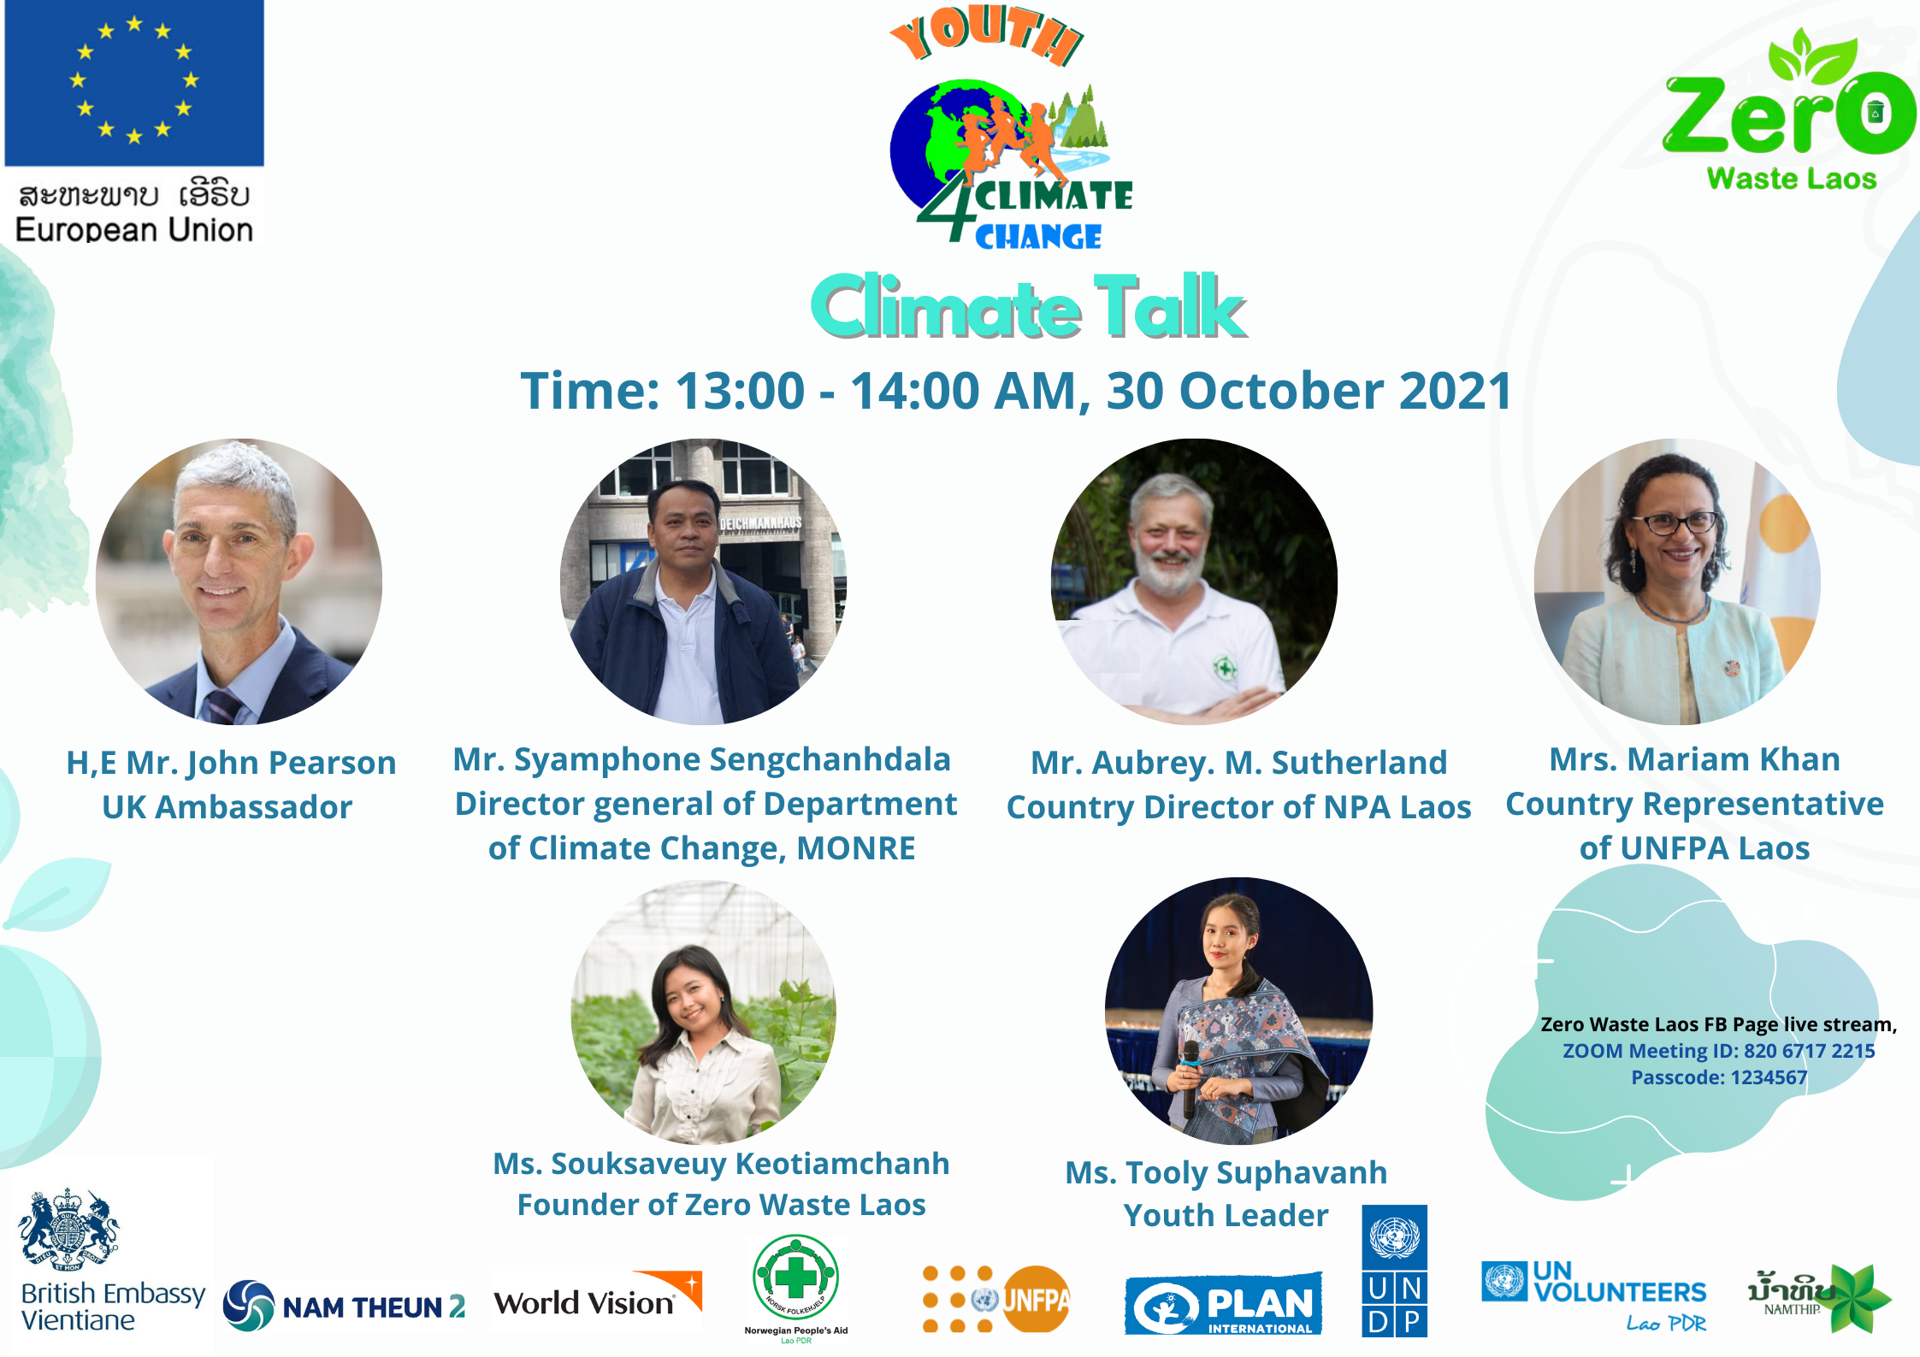
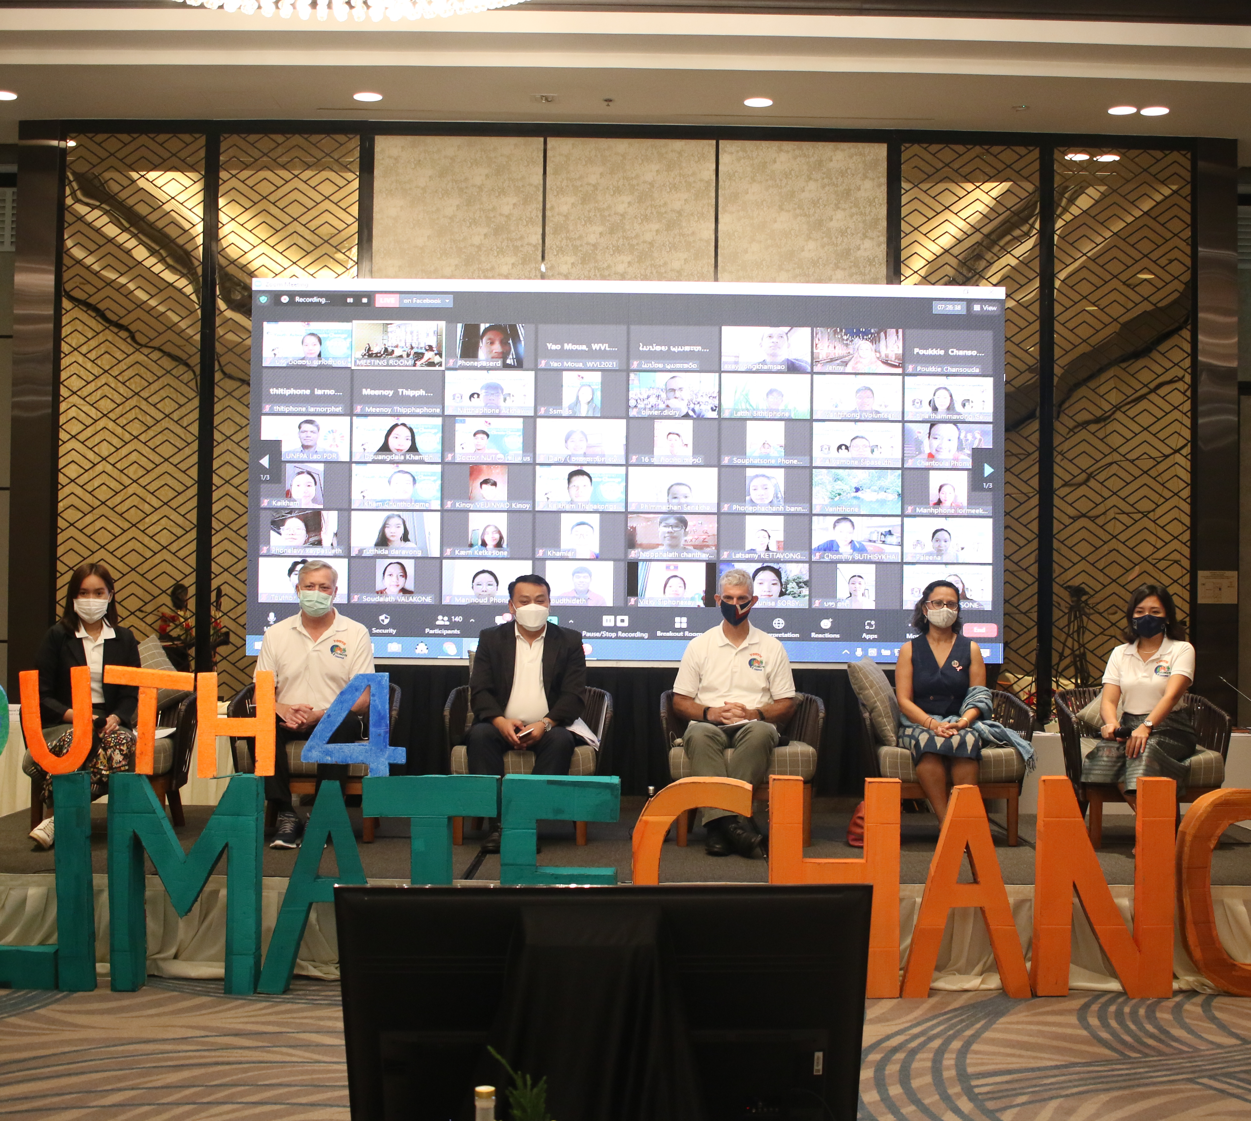
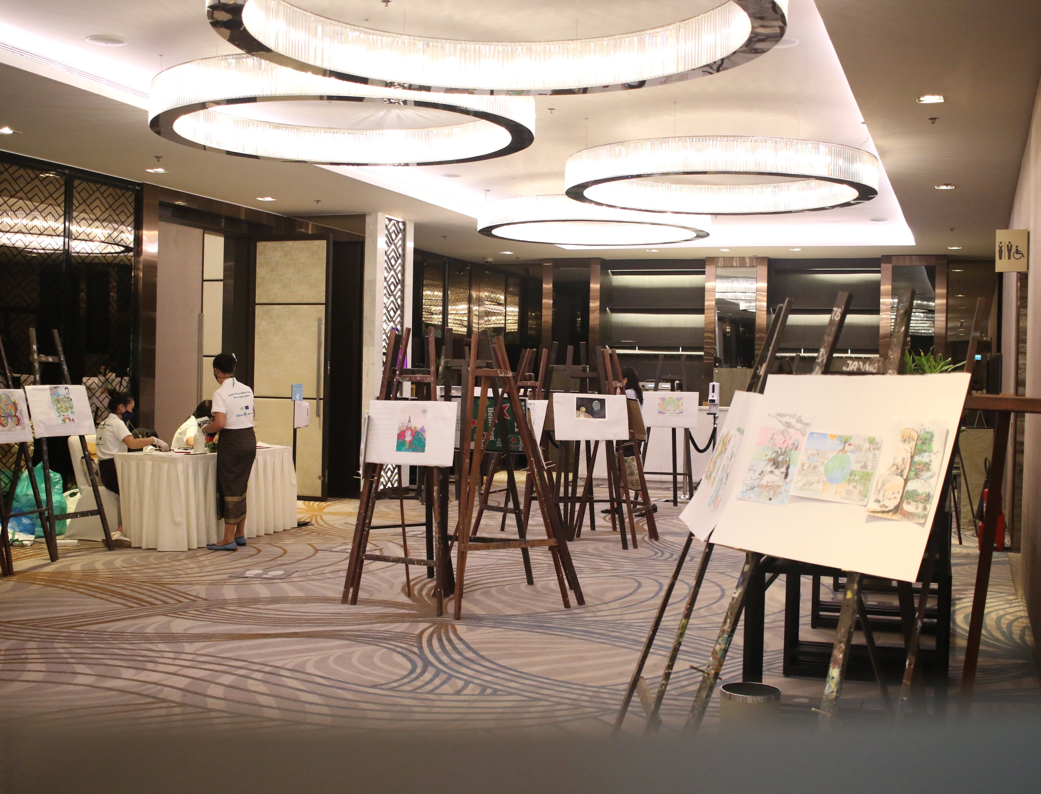
Youth 4 Climate Action
NPA supported Youth for Climate Program together with 12 organization
This could engage 30,000 people in social media platform throughout various activities such as drawing competition, online workshops, webinar, case challenges
180 people participated in the event via online and in person

Slide 14
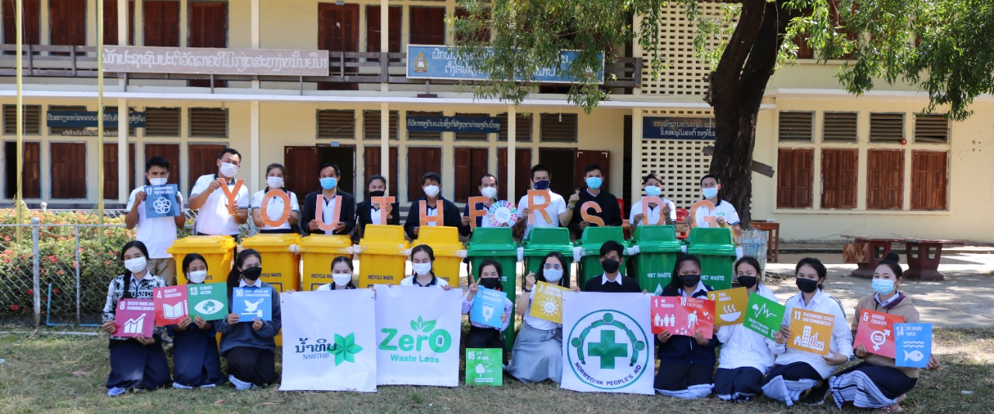
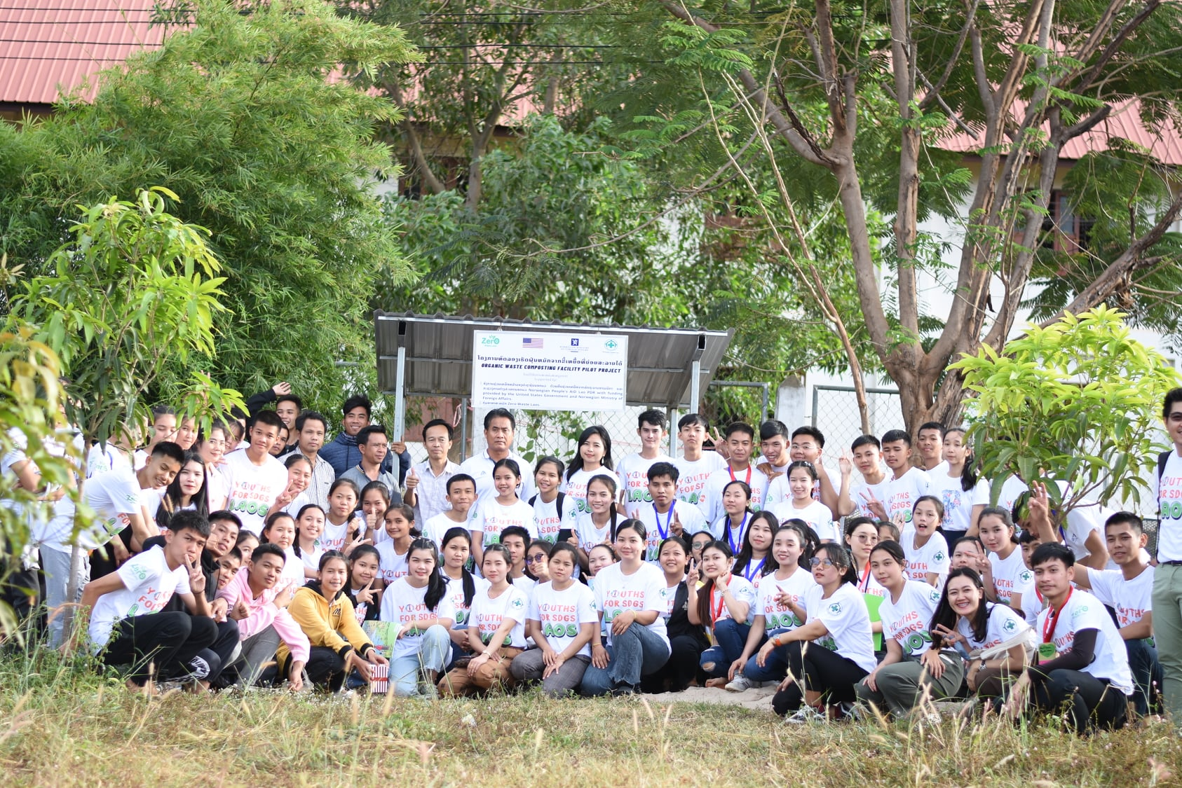
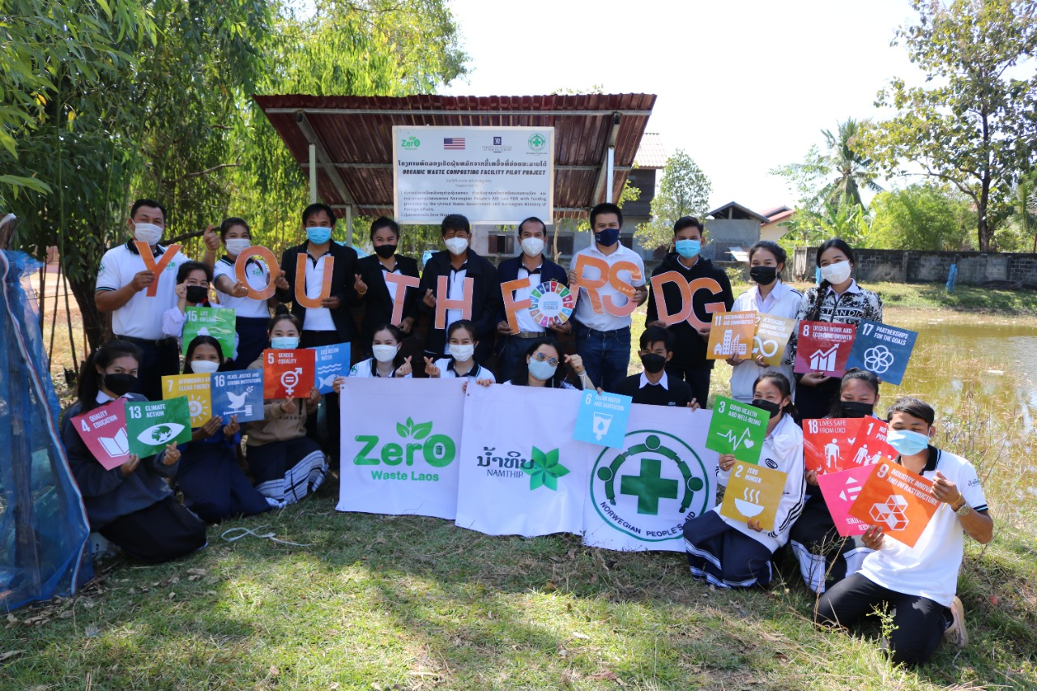
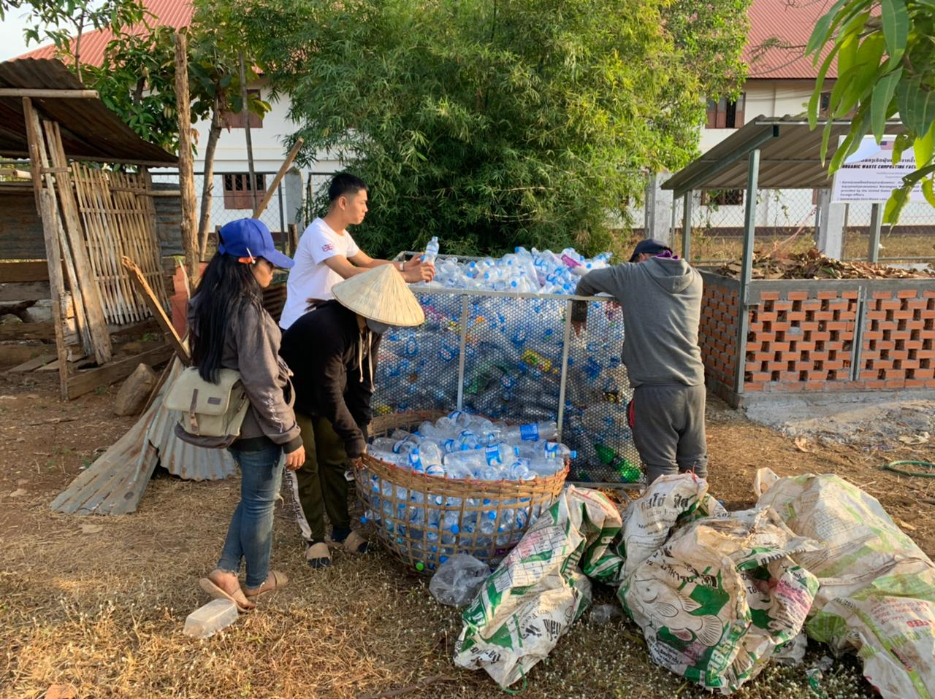
Youth 4 SDGs in 3 provinces of Southern Laos
Set up recycling points and connecting with Junkshops
Build composting facilities
Hand over waste bins
Raising awareness
SDGs quests

Slide 15
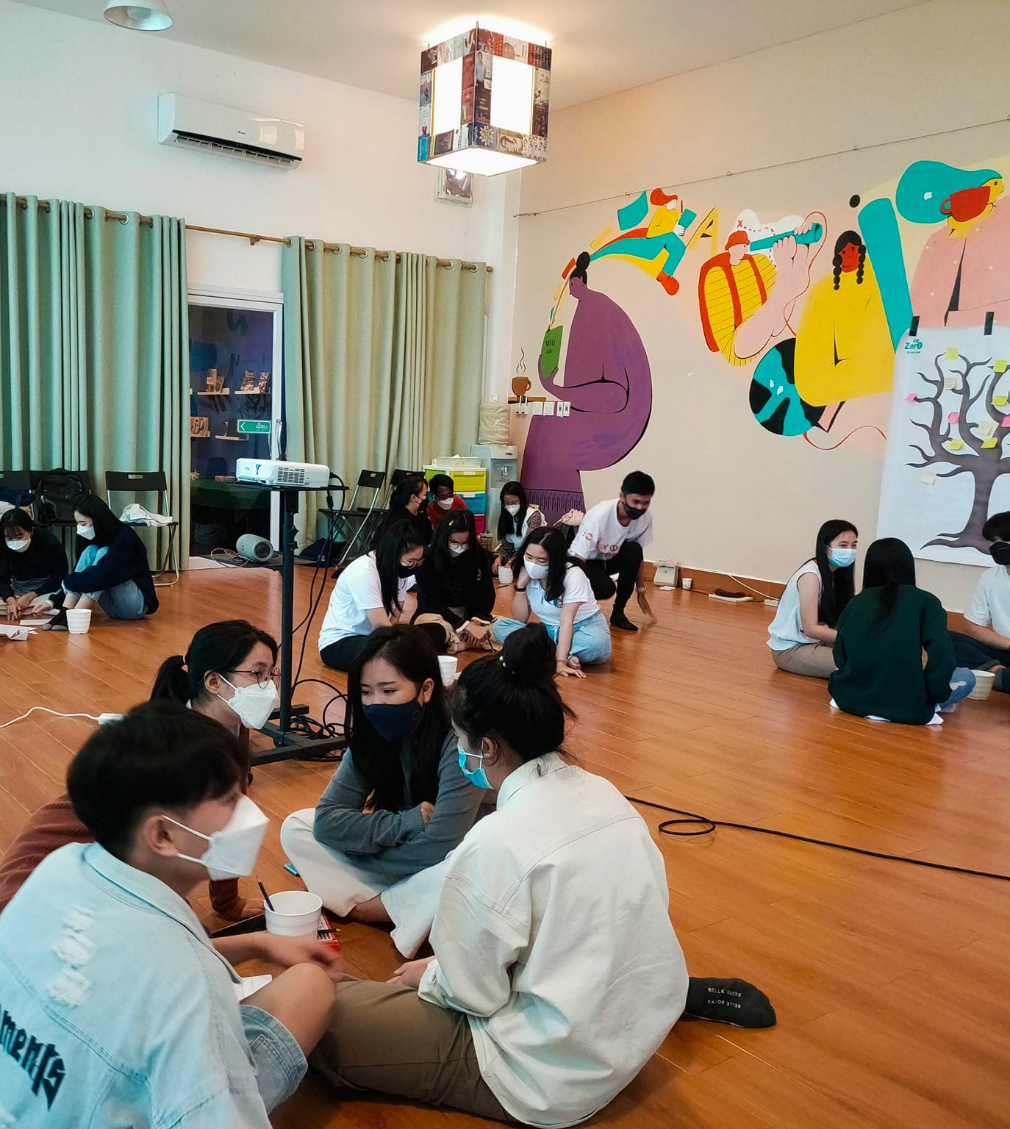
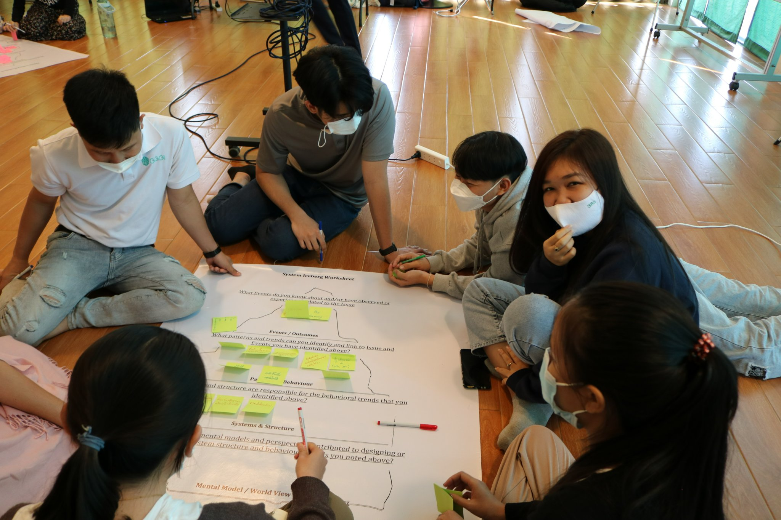
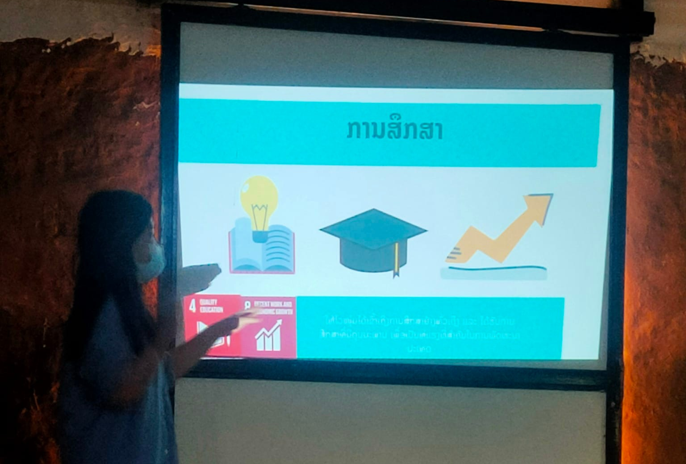
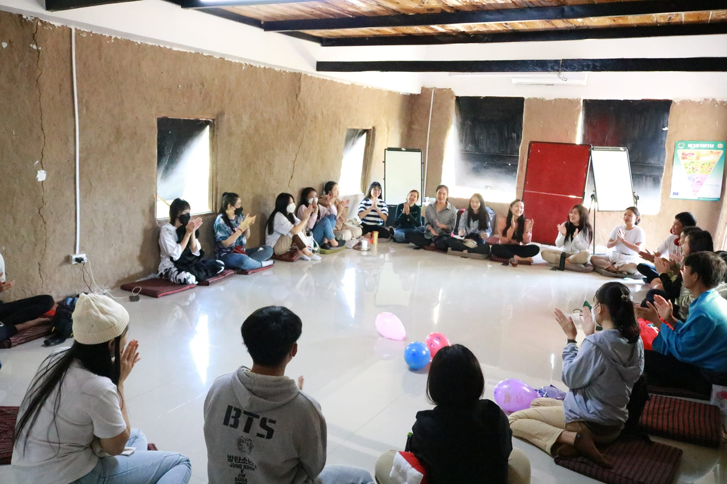
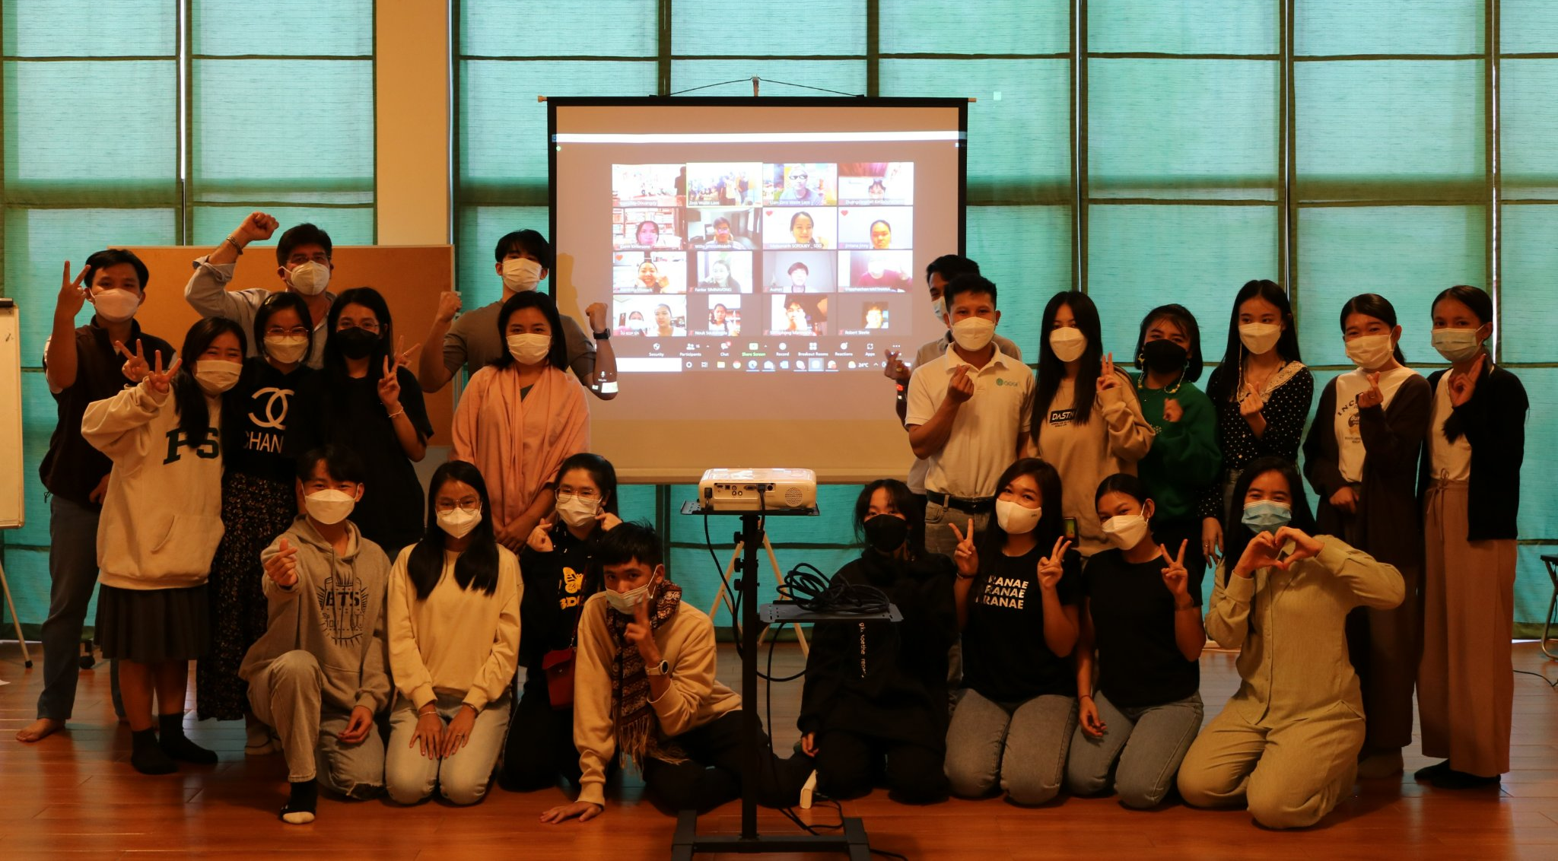
Sustainability Leader Program
30 youth Leaders participated in the program
The program agenda included:
System Thinking
Sustainability mindset
Soft skill training
SDGs presentation

Slide 16
Next Step 2022
Green office and green operation
Validate with an activity map
Developing or establishing a baseline data collection
Benchmarking with other yet similar examples and dashboard
Set up an action plan, implement the tools
Monitoring and auditing systems set up for checking compliances, gains/progress leanings and improvement
Environmental focal person or green ambassadors to be assigned and provide training to them and all staff.
Strategy and environmental standard:
Meeting with government counterpart and stakeholders
Organize consultation meeting with stakeholders (it might take 2-3 consultation meetings before the endorsement)
Facilitate and update the strategy and environmental stand when there is feedback
Green Activity and support youth movements:
Monitoring and follow up to make sure it can be sustained
Continue support the Youth for Climate and Youth for SDGs program
Find out the potential of expanding after the operation in the previous school is smoothly

Slide 17
Q&A

