Slide 1
Welcome
Working Group Environmental issues and mine action
22 February 2023
Note : Session is being recorded – to help take minutes only
Today’s Facilitators :
Linsey Cottrell & Kristin Holme Obrestad

Slide 2
Agenda – 13:00 to 14:00
Introductions from any new attendees
Updates on any environmental activities by organizations
Presentation –Gunnar Rundgren, Sustainable Farming
Update on IMAS 07.13
AOB - for online attendees leaving at 14:00
Date for next meeting

Slide 3
Agenda – 14:00 to 15:00
Reflections on 2022, previous meetings and topics covered to date
Any changes needed to format and structure
Areas for focus and outputs for 2023
Platform for future consultations and surveys
Comfort and coffee break

Slide 4
Agenda – 15:15 to 17:00
Outreach opportunities to others and increasing engagement across mine action
Strategy for links with other groups, such as the EHAN and PEDRR
Review and update of the group’s terms of reference
Year ahead, notable dates and key events
Any other business
Agree actions for next meeting

Slide 5
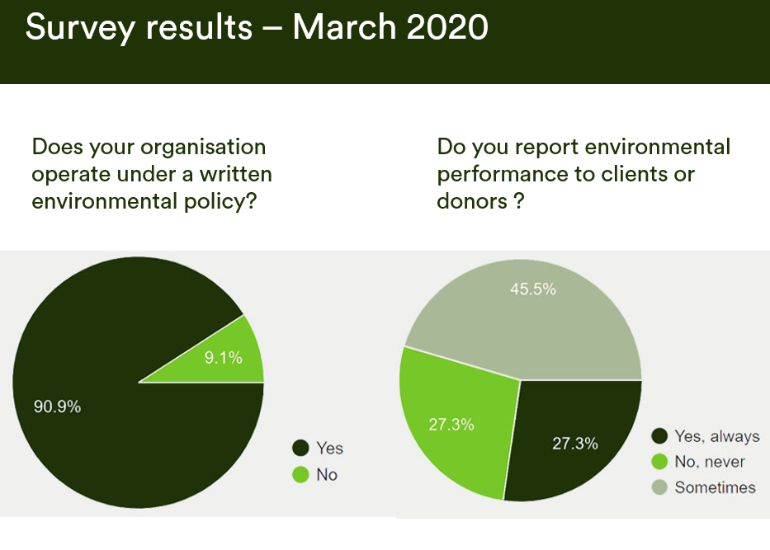
Previous meetings and topics covered

Slide 6
Previous meetings and topics covered

Slide 7
Previous meetings and topics covered

Slide 8
Previous meetings and topics covered
Before
After

Slide 9
Events, points of interest…
8 March – International Women’s Day
22-23 March – Environment and Emergencies Forum (EEF), UNEP/OCHA.
4 April - International Day for Mine Awareness
17-28 April - Humanitarian Networks and Partnerships Weeks (HNPW)
22 April – Earth Day
5 June – World Environment Day
5-15 June – Bonn pre-sessionals Climate Change Conference
26-30 June – APMBC Intersessional meetings

Slide 10
Linkedin : EIMA Group https://www.linkedin.com/groups/8933777/
Google DRIVE: https://drive.google.com/drive/folders/0AOsropLVHQD5Uk9PVA Key dates | Agenda | Previous minutes | Library | TOR
Key links

